Slide 1
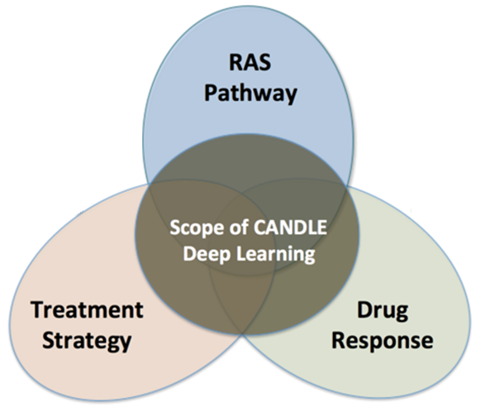

Programmable Infrastructure for Diverse, Scalable Learning at Exascale
EXASCALE tools for scientific workflows
drhgfdjhngngfmhgmghmghjmghfmf
Justin m Wozniak
and the CANDLE Team Data Science & Learning Division Argonne National Laboratory
woz@anl.gov
PASC July 7, 2021

Slide 2
CANDLE
CANDLE (PI: Rick Stevens) is an Argonne led multi-DOE lab collaboration developing a suite of software to support scalable deep learning for cancer applications on DOE supercomputing resources
Funded by the DOE Exascale Computing Project
Developing implementations of deep neural networks on targeted problems related to the three core DOE-NCI Joint Design of Advanced Computing Solutions for Cancer (JDACS4C) pilot projects
GitHub: http://github.com/ECP-CANDLE

Slide 3
PROJECT OVERVIEW

Slide 4
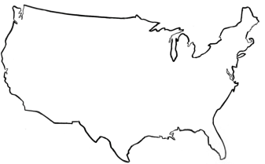
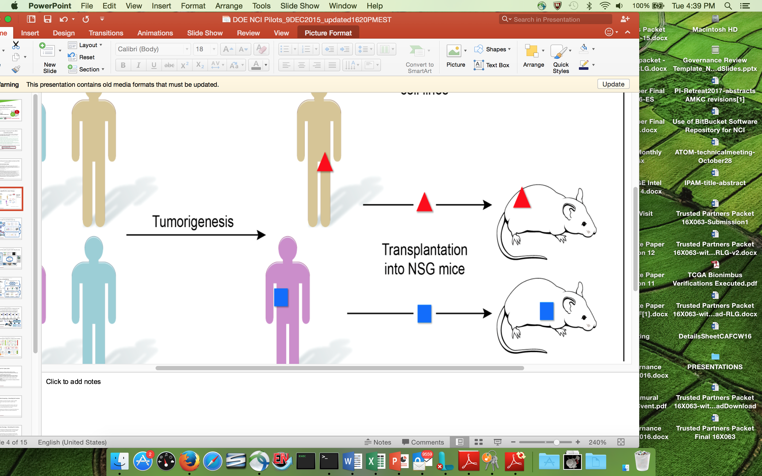
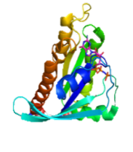
CANDLE: Application goals
Deliver high performance tools and techniques to partners in cancer research
Achieve and demonstrate utility of exascale hardware on cancer problems
Focus on “Benchmarks” developed by other projects (some same personnel)
Apply extreme parallelism to application-level problems
Exascale
technologies driving advances
NCI
National Cancer Institute
DOE
Department
of Energy
Cancer driving computing advances
Clinical Domain – Precision oncology surveillance
Expanded SEER database information capture
Modeling patient health trajectories
Pre-clinical Domain – Improved predictive models
Computational/hybrid predictive models of drug response
Improved experimental design
Molecular Domain – Multiscale biological models
Models for RAS-RAS complex interactions
Insight into RAS related cancers

Slide 5
Parallelism strategies
10,000 x 10-1000 x 10-100 = 1M – 1000M processing elements
Hyperparameter Search: up to ~10,000x
Depends on search strategy
Data Parallel: 10x-1000x
Data Parallel
10x-1000x
Model
Parallel
10x-100x
Model
Parallel
10x-100x
Model
Parallel
10x-100x
Model
Parallel
10x-100x
Model
Parallel
10x-100x
...
...
...

Slide 6

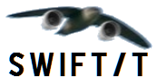






Deep learning on supercomputers
Steep learning curve with myriad technologies
Workflow manager (Swift/T, EMEWS) ; Scheduler ; scripting
Deep learning (Keras, TensorFlow, Horovod)
Optimization algorithms (R, Python)
MPI implementation (MVAPICH, Open MPI)
etc. …

Slide 7
WORKFLOW support for ML frameworks
Concurrency:
Scalable task distributor
Intranode concurrency, accelerators left up to the framework
Multinode ML tasks are parallel tasks
Data management:
Could reuse input staging methods
Intermediate caches via DataSpaces/Mochi
Software integration:
Usually launch frameworks in separate process
Launching within process is a configuration challenge
Search methods launched within process

Slide 8
CANDLE/Supervisor Goals
Develop an exascale deep learning environment for cancer
Building on open source deep learning frameworks
Optimization for CORAL and exascale platforms
Support all three pilot project needs for deep learning
Collaborate with DOE computing centers, HPC vendors and ECP co-design and software technology projects
Mission statement: Enable the most challenging deep learning problems in cancer research to run on the most capable supercomputers in the DOE
Provide a path forward for machine learning applications at the largest scale…

Slide 9
SUPERVISOR ARChitecture

Slide 10
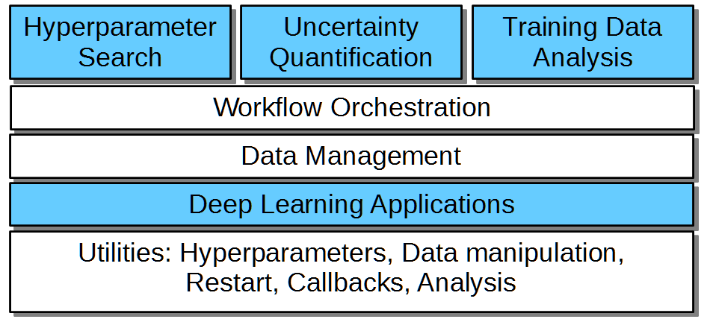
CANDLE/Supervisor overview
CANDLE/Supervisor consists of several high-level workflows:
Capable of modifying/controlling application parameters dynamically as the workflow progresses and training runs complete
Distribute work across large computing infrastructure, manage progress
Underlying applications are Python programs that use Keras/TensorFlow
“User code” shown in blue
“Utilities” shown in white
New studies would be developed by modifying the blue sections

Slide 11
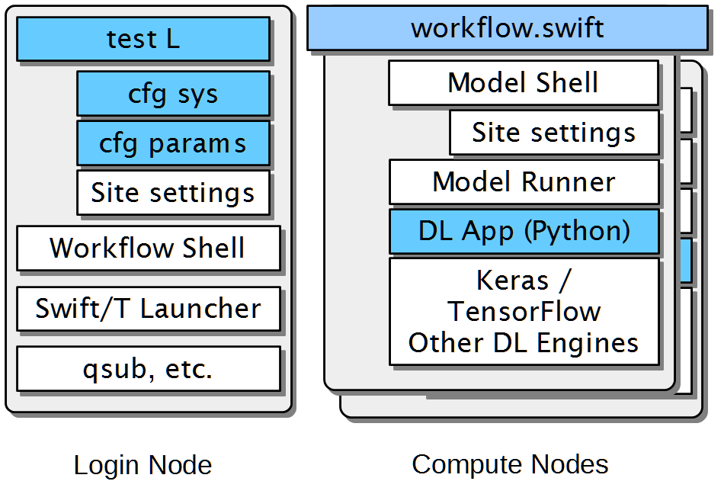
CANDLE/Supervisor Implementation
Runs start with a test script
CFG scripts contain settings for a system or parameters for a given study (e.g., search space)
Reusable site settings
The workflow shell script sets up the run
Swift/T launches and manages the workflow
Reusable Model scripts set up each app run
The DL app uses Keras/TF plus CANDLE Python utilities

Slide 12
Example workflows

Slide 13
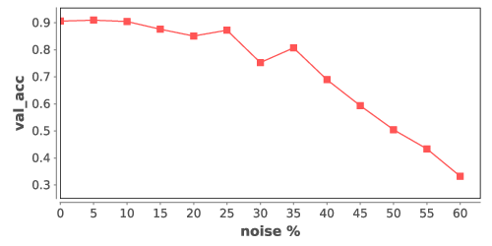
Example: robustness under noise
Simple parameter sweep- measure impact of bad data injection into NT3 model
Workflow script loops over range of noise levels and trials
Parallel loops expose all work to the system concurrently
JSON fragment is assembled with CANDLE hyperparameters
CANDLE obj() function invokes the model scripts to run NT3
Resulting validation accuracy is simply printed to the screen
All runs on ALCF Theta, 4,392-node Xeon Phi system
float noise_levels[] = [0:num_noises];
int trials[] = [0:num_trials-1];
foreach level, i in noise_levels {
foreach trial, j in trials {
run_id = "%02i-%02i" % (i, j);
json = "{\"noise_level\":%f}"%noise_level;
noise_level = level * noise_step;
result = obj(json, run_id);
printf("result %s : noise %0.3f : %s",
run_id, noise_level, result);
}
}

Slide 14
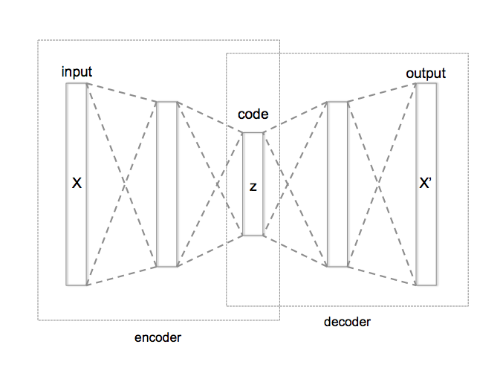
WHAT IS HYPERPARAMETER OPTIMIZATION?
Hyperparameter optimization = HPO
Neural networks have a large number of possible configuration parameters, called hyperparameters
Avoids collision with NN weights, which are sometimes called parameters
Applying optimization can automate part of the design of the neural network
In the cancer Pilot 1 autoencoder shown, the system can determine
How many neurons to put in each layer
What activation function to use
What batch size to use
Etc.

Slide 15
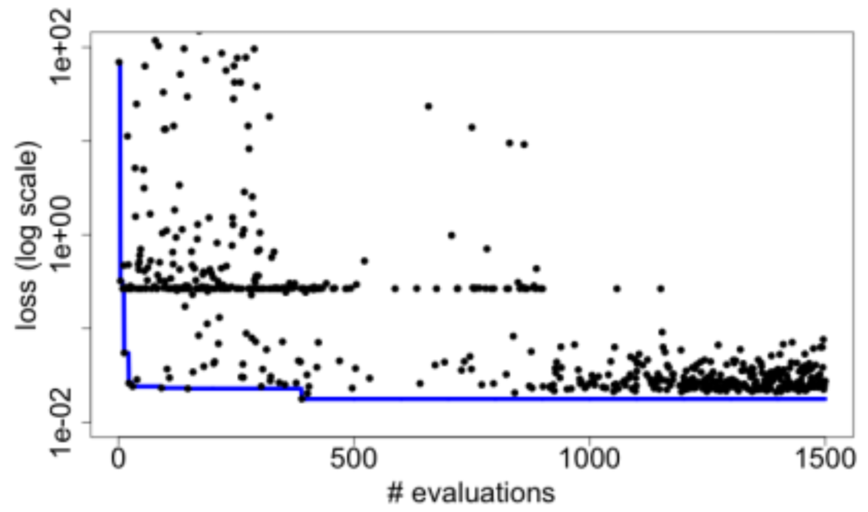
Example: Hyperparameter optimization
Search for the best combination of hyperparameters for a given DL app- neuron counts, functions, etc.
Optimize for validation loss, a measure of error
Use an external R library to perform the optimization
Iteratively receive trial hyperparameters, evaluate them with the obj() function, return results
Algorithm terminates after convergence or iteration limit
for (boolean b = true, int i = 1;
b; b=c, i = i + 1) {
string params = EQR_get(ME);
boolean c;
if (params == "DONE") {
string finals = EQR_get(ME);
c = false;
} else {
string param_array[] = split(params, ";");
string results[];
foreach param, j in param_array {
run_id = "%i_%i_%i" % (restart, i, j);
results[j] = obj(param, run_id);
}
string result = join(results, ";");
EQR_put(ME, result) => c = true;
}
}

Slide 16
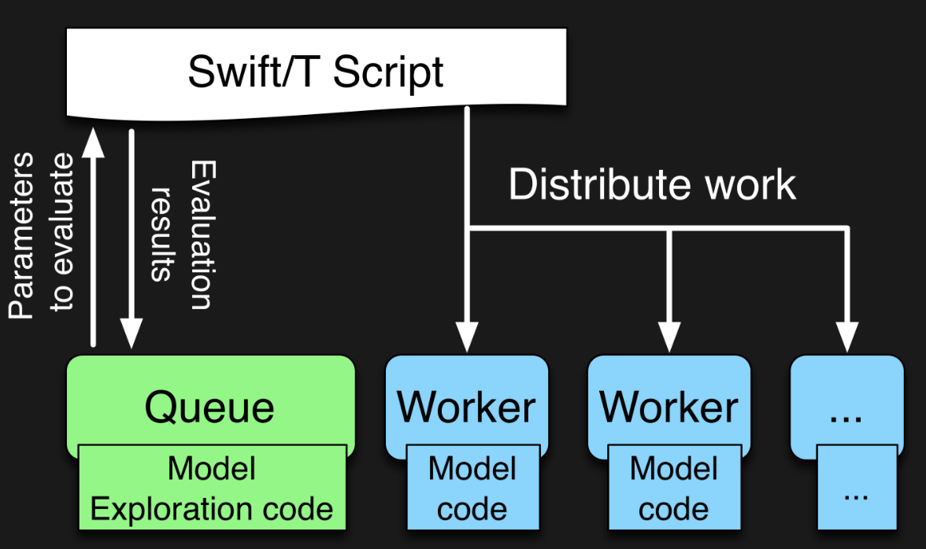

EMEWS workflow structure
The core novel contributions of EMEWS are shown in green, these allow the Swift script to access a running Model Exploration (ME) algorithm, and create an inversion of control (IoC) workflow
Both green and blue boxes accept existing multi-language code
http://emews.org

Slide 17
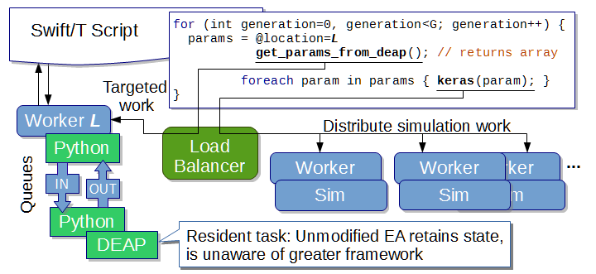
EMEWS: Extreme-scale model exploration workflows in Swift/T
How do we couple complex model exploration algorithms with workflows?
Optimization, active learning, uncertainty quantification…
http://emews.org
From desktop to large-scale model exploration with Swift/T Proc. Winter Simulation Conference 2016

Slide 18
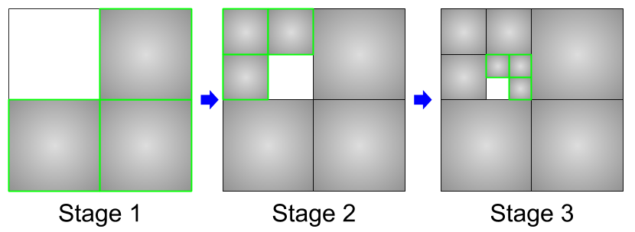
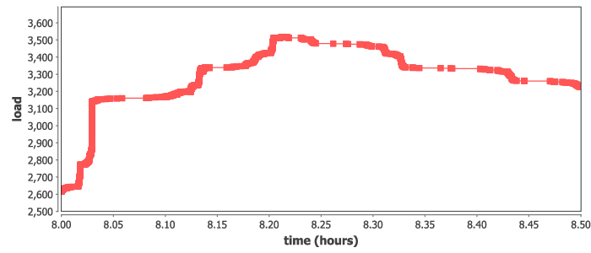
Example: INCREMENTAL learning
Split up the training data into subsets, iteratively train on most remaining subsets.
Weight sharing from one subset to the next (incremental learning)
Allows for investigations into data quality and learning patterns
Could also boost performance by preventing overloading data ingest limits
Recursive calls define the datasets for train
Runs at large scale on Summit, ramp-up/down
run_stage(int N, int S, string this, int stage,
void block, string plan_id) {
void parent = run_single(this, stage, block, plan_id);
if (stage < S) {
foreach id_child in [1:N] {
run_stage(N, S, this+"."+id_child, stage+1, parent,
plan_id, db_file, runtype);
}}
}
run_single(string node, int stage, void block) {
json_fragment = make_json_fragment(node, stage);
json = "{\"node\": \"%s\", %s}" % (node, json_fragment);
block => obj(json, node);
}

Slide 19
Infrastructure details

Slide 20

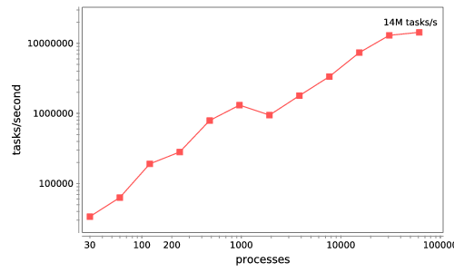


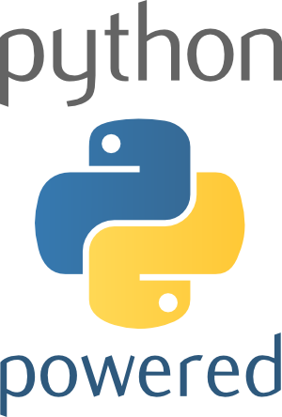



Swift/T: Enabling high-performance Scripted workflows
Supports tasks written in many languages
Write site-independent scripts, translates to MPI
Automatic task parallelization and data movement
Invoke native code, script fragments
Rapidly subdivide large partitions for MPI jobs in multiple ways
Swift/T control process
Swift/T worker
C
C++
Fortran
C
C++
Fortran
MPI
C
C++
Fortran
64K cores of Blue Waters
2 billion Python tasks 14 million Pythons/s
Swift/T: Scalable data flow programming for distributed-memory task-parallel applications Proc. CCGrid 2013.
$ spack install stc
$ conda install -c lightsource2-tag swift-t

Slide 21
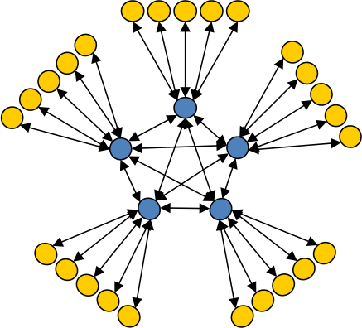
Asynchronous Dynamic Load Balancer
ADLB for short
workers
An MPI library for master-worker workloads in C
Uses a variable-size, scalable network of servers
Servers implement work-stealing
The work unit is a byte array
Optional work priorities, targets, types
For Swift/T, we added:
Server-stored data
Data-dependent execution
masters
Lusk et al. More scalability, less pain: A simple programming model and its implementation for extreme computing. SciDAC Review 17, 2010

Slide 22

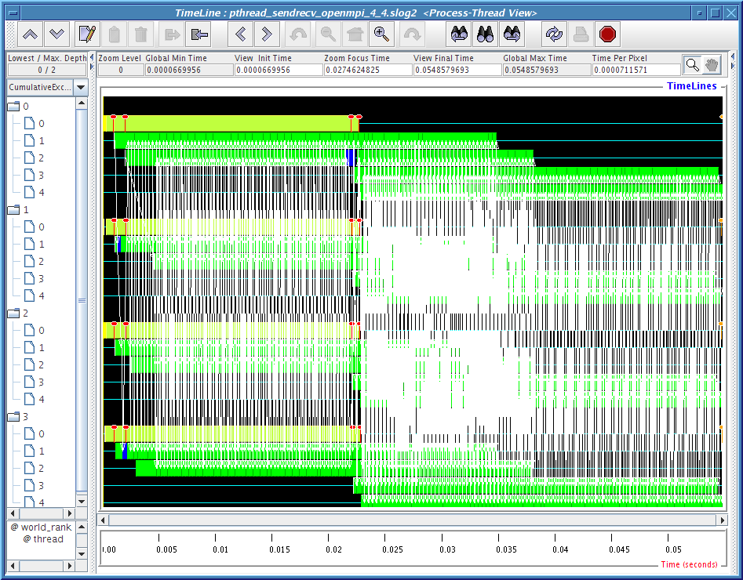
MPI: The Message Passing Interface
Programming model used on large supercomputers
Can run on many networks, including sockets, or shared memory
Standard API for C and Fortran; other languages have working implementations
Contains communication calls for
Point-to-point (send/recv)
Collectives (broadcast, reduce, etc.)
Interesting concepts
Communicators: collections of communicating processing and a context
Data types: Language-independent data marshaling scheme

Slide 23
Parallel tasks in CANDLE workflows
Complex concurrency structures
Model parallelism: running the same network across nodes
Library approach:
Use Swift/T @par syntax
Uses MPI 3 to dynamically create communicator from group
User task library accepts communicator via function input
Approach developed for other scientific computing cases, LAMMPS, NAMD, DIY, etc.
Have patched Horovod library
Should work with LBANN
MPI_Launch approach
Use Swift/T launch() function
Creates MPI 3 group
Launches mpiexec on those resources, creating a new MPI_COMM_WORLD and separate processes (fault tolerance)
Works on clusters and Cray
Would work with unmodified Horovod or LBANN

Slide 24
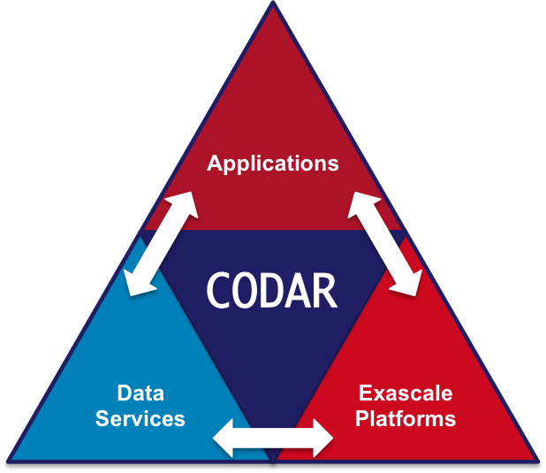
ECP Interaction: CODAR, CANDLE
CANDLE workflows produce a great number of medium-sized ML models
Goal: Cache these on compute node storage for possible later use. Need to flush to global FS before end of run, but many models will be discarded
Approach: Integrated Swift/T workflow system used in CANDLE with DataSpaces client
Provide an opportunity for workflow-based data analysis and I/O reduction
Demonstrate the utility of node-local storage for complex workflows
Scaling deep learning for cancer with advanced workflow storage integration. Proc. MLHPC @ SC 2018.
Swift/T training workflow
…
CANDLE benchmark
CANDLE
TensorFlow
TensorFlow
Good NN model
DataSpaces
Parallel FS

Slide 25
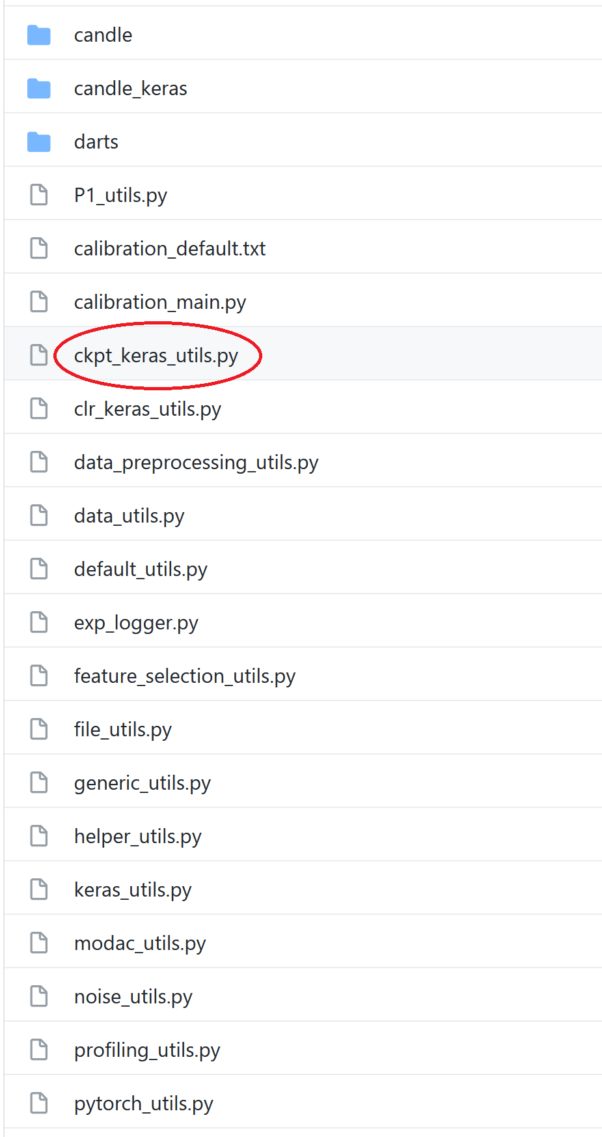
CANDLE Checkpointing library
ckpt_keras_utils: High-level checkpoint/restart policy controls
CANDLE workflows call Keras or other deep learning engines via the candle_model() workflow function
The model receives a set of hyperparameters, which specify the neural network and also other settings
New settings provide high-level controls over when to restart, when to checkpoint, how to checkpoint, and how long to retain old checkpoints
Available checkpoint settings include intervals and loss metrics, with or without checksums, with automatic naming
Available checkpoint retention settings include intervals and simple counts

Slide 26
FUTURE WORK

Slide 27
Next steps in exascale learning
Enable rapid prototyping via massive parallelism for new workflows
Quickly scale new methods from Python notebooks to supercomputers
Support quick ‘what if’ scenario evaluation for a range of questions
Reusable,
Extensible
ApplicationModels
Reusable,
Extensible
Workflows
Reproducible,
Rapid
Cancer Science
+

Slide 28
QUESTIONS?

Slide 29
QUESTIONS?
This research was supported by the Exascale Computing Project (17-SC-20-SC), a joint project of the U.S. Department of Energy’s Office of Science and National Nuclear Security Administration, responsible for delivering a capable exascale ecosystem, including software, applications, and hardware technology, to support the nation’s exascale computing imperative.

